Slide 1


SMART INDIA HACKATHON 2025
TITLE PAGE
Problem Statement ID – SIH25028
ProblemStatementTitle-Smart Classroom & Timetable Scheduler
Theme- Smart Education
PS Category- Software
Team ID-
Team Name – Timetable Techstorm

Slide 2


Smart Education
Proposed Solution
Automated timetable generation for students
Login system (student register number + password)
Personalized learning links
Search by date & highlights the day
Fully responsive web app
Subject-wise YouTube links

Slide 3
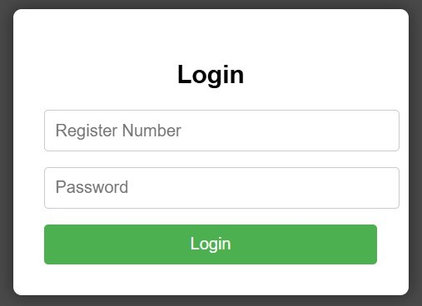
TECHNICAL APPROACH
Technologies: HTML, CSS, JavaScript
Methodology:
Login verification with pre-set users
Timetable auto-generated for 2 weeks
Dynamic subject links mapped
Highlight & search features
Responsive design for mobile/desktop
Prototype: Working HTML/JS app

Slide 4
FEASIBILITY AND VIABILITY
Feasibility:
Lightweight, browser-based (no server needed)
Easy deployment in colleges
Challenges:
Security (currently simple password)
Scaling to multiple semesters/branches
Solutions:
Extend to database authentication
Admin panel for timetable updates

Slide 5
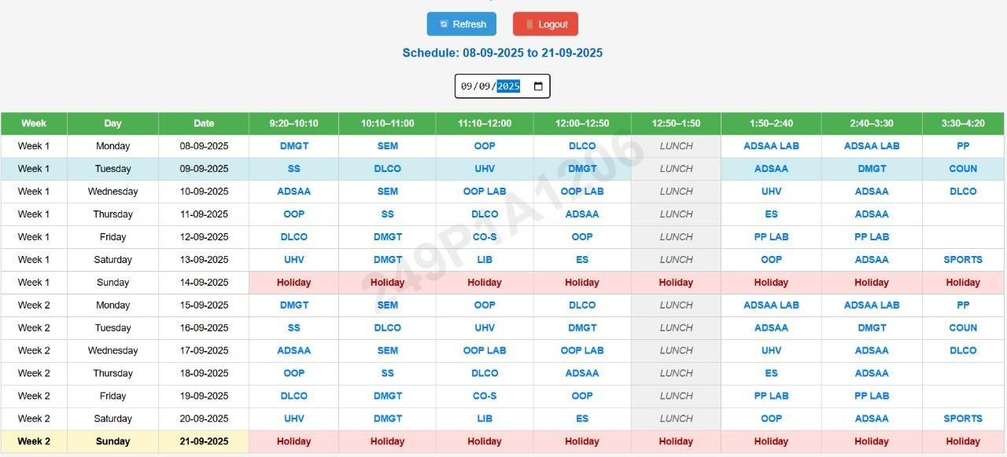
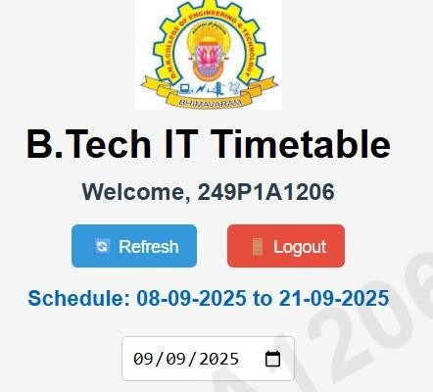
IMPACT AND BENEFITS
Students: Access timetable + learning resources instantly
Faculty/Admin: No need to distribute physical timetables
Benefits:
Saves time & paper
Digital learning integration (YouTube links)
Improves student engagement

Slide 6
RESEARCH AND REFERENCES
YouTube Learning Resources (subject playlists)
W3Schools (HTML/CSS/JS references)
Smart India Hackathon Guidelines
https://aathavamadhu-dev.github.io/timetable/

